Slide 1


Slide 2


Data Organisation in Spreadsheets
Brian Tsz Ho Wong
University of Edinburgh
t.h.wong-2@sms.ed.ac.uk

Slide 3

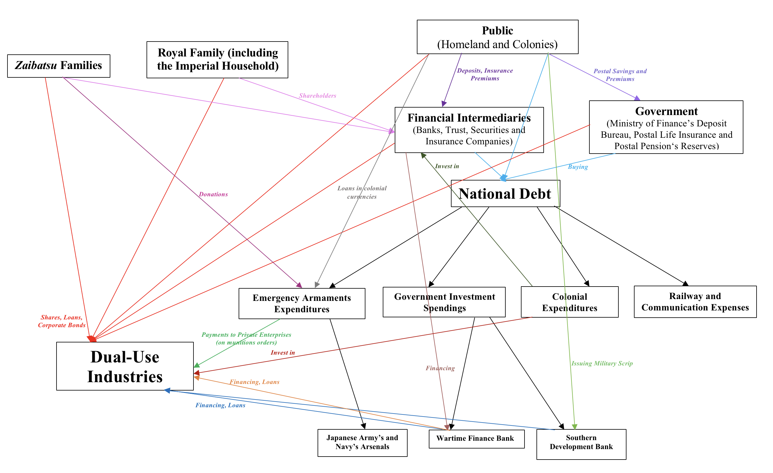


Before starting …
Who am I
I am a second-year PhD student in Asian Studies
Researching the economic and financial mobilisation of wartime Japanese Empire
Training Fellow with DCS
Contributor to the Digital Orientalist

Slide 4
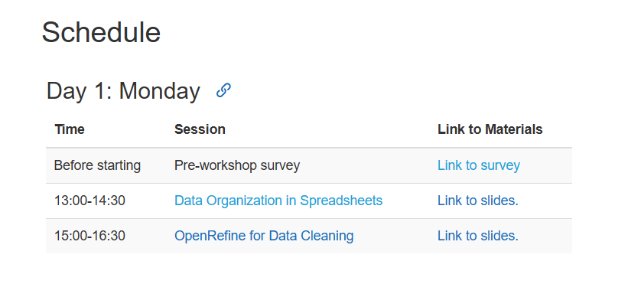
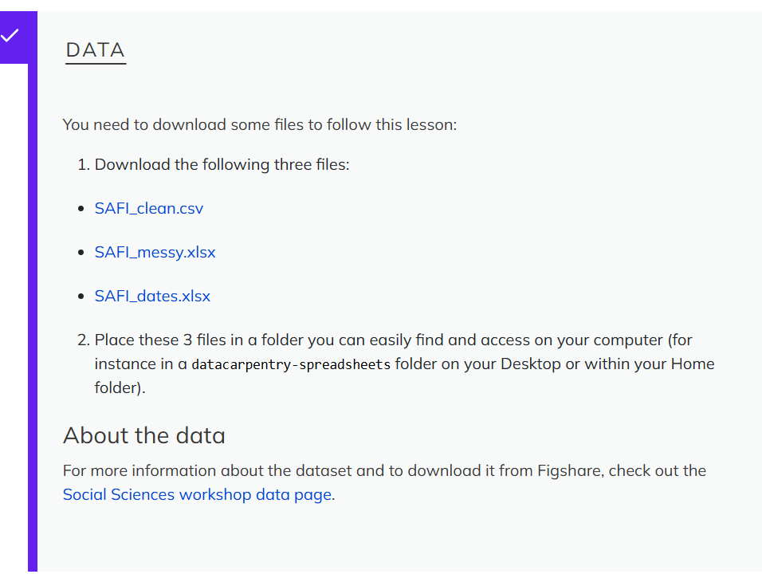
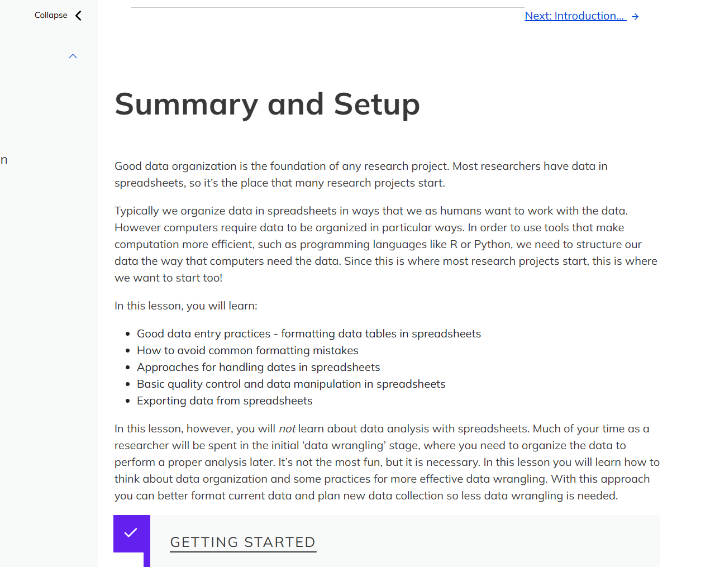


Setup
Workshop page: https://dcs-training.github.io/2024-11-18-CDCS-Carpentry-Social-Sciences/

Slide 5

Plan of the Workshop
1. Introduction
2. Formatting data tables in Spreadsheets
3. Formatting problems
4.Dates as data
5. Quality assurance
6. Exporting data

Slide 6

1. Introduction
Good data organization is the foundation of your research project. Most researchers have data or do data entry in spreadsheets. Spreadsheet programs are very useful graphical interfaces for designing data tables and handling very basic data quality control functions.
In this lesson, we’re going to talk about:
Good data entry practices - formatting data tables in spreadsheets
How to avoid common formatting mistakes
Recognising and reformatting dates in spreadsheets
Basic quality control and data manipulation in spreadsheets
Exporting data from spreadsheets

Slide 7
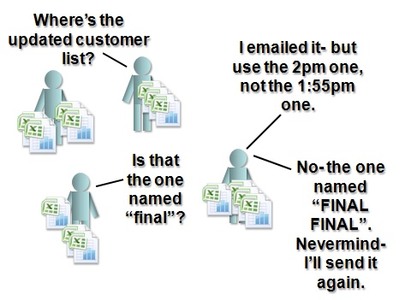
1. Introduction
Problems with Spreadsheets
One tool for many use, good for data entry, annotation, visualisation, plotting.
Spaces, merged cells, colour and grids may aid readability but are not easily handled by other programs that take our spreadsheet as an input to further analysis.
It can be very difficult, if not impossible, to replicate your steps when you do statistics.
Make it too easy for bad researchers to deliberately falsify data (https://datacolada.org/109).
Also make it very easy for good researchers to accidently vandalise their own data.
They are terrible if you need to refresh data but keep any formulas/ transformations.

Slide 8

1. Introduction
Problems with Spreadsheets – cont.
When performing calculations in a spreadsheet, it’s easy to accidentally apply different formula to multiple adjacent cells.
Difficult to demonstrate data quality and consistency in our analysis.
Sometimes inherit spreadsheet form colleagues and need to use those data.
They are not built to handle large datasets Excel: Why using Microsoft's tool caused Covid-19 results to be lost - BBC News.
They get very easily confused by things they think might be dates.

Slide 9

Discussion/Confession Time
1. Introduction
How many people have used spreadsheets in their research?
How many people have accidentally done something that made them frustrated or sad?
What did you do?
Notes:
3 minutes

Slide 10
What you will not Learn Today
1. Introduction
Not learn how to do statistics and data analysis in a spreadsheet.
Not learn how to do plot in a spreadsheet (do your scheming elsewhere).
Not learn how to write code in spreadsheet programs.
Instead, we will Learn
How to format data tables in spreadsheets.
How to identify data formatting problems.
How to work with dates as data.
How to ensure Quality control of our data.
How to export data.

Slide 11
2. Formatting data tables in Spreadsheets
Questions
What are some common challenges with formatting data in spreadsheets and how can we avoid them?
Objectives
Recognise and resolve common spreadsheet formatting problems.
Describe the importance of metadata.
Identify metadata that should be included with a dataset.

Slide 12
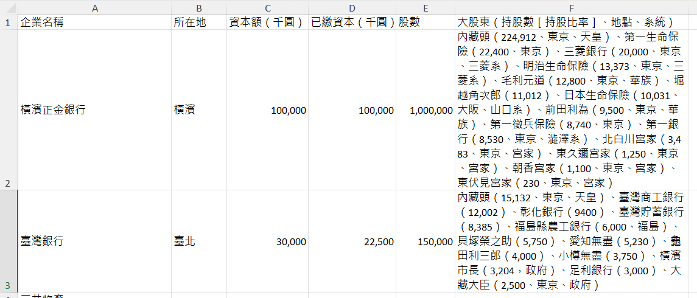
2. Formatting data tables in Spreadsheets
Data formatting problems
Common mistake - treating spreadsheet programs like lab notebooks
That is, we try to Rely on context, notes in the margin, spatial layout of data and fields
Human friendly != computer friendly.
We can manage and analyse data in much more effective and faster ways, but to use that power, we have to set up our data for the computer to be able to understand it.
Set up well-formatted tables from the outset - before you even start entering data from your very first preliminary experiment. Data organization is the foundation of your research project.

Slide 13
2. Formatting data tables in Spreadsheets
Keeping track of your analyses!!!
When you’re working with spreadsheets, during data clean up or analyses, it’s very easy to end up with a spreadsheet that looks very different from the one you started with. To be able to reproduce your analyses or figure out what you did when Reviewer #2 asks for a different analysis, you should:
Create a new file or tab with your cleaned or analysed data. Don’t modify the original dataset, or you will never know where you started!
Keep track of the steps you took in your clean up or analysis. You should track these steps as you would any step in an experiment. You can do this in another text file, or a good option is to create a new tab in your spreadsheet with your notes. This way the notes and data stay together.
Put these principles in to practice today during the exercises!

Slide 14
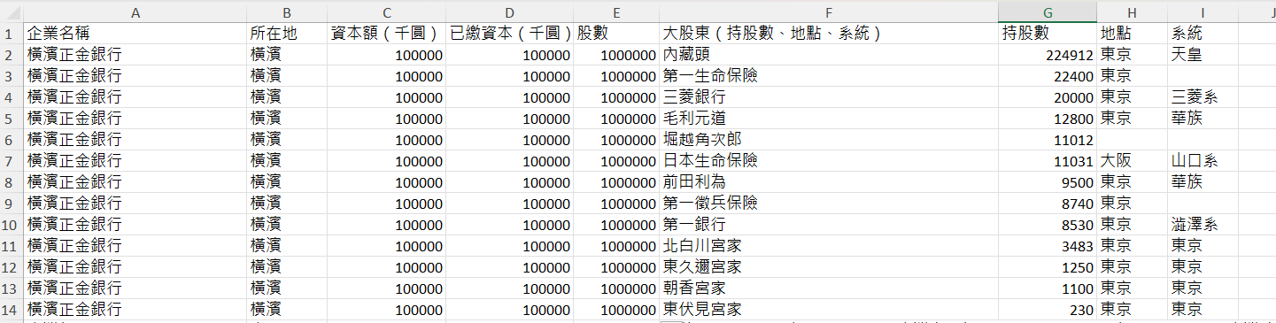
2. Formatting data tables in Spreadsheets
Structuring data in spreadsheets
The cardinal rules of using spreadsheet programs for data:
Put all your variables in columns - the thing you’re measuring, like ‘weight’ or ‘temperature’.
Put each observation in its own row.
Don’t combine multiple pieces of information in one cell. Sometimes it just seems like one thing, but think if that’s the only way you’ll want to be able to use or sort that data.
Leave the raw data raw - don’t change it!
Export the cleaned data to a text-based format like CSV (comma-separated values) format. This ensures that anyone can use the data and is required by most data repositories.

Slide 15
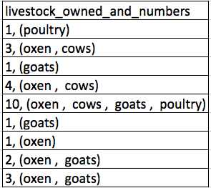
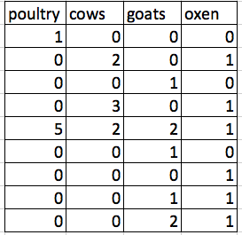
2. Formatting data tables in Spreadsheets
Structuring data in spreadsheets
Today, we’re going to be working with data from a study of agricultural practices among farmers in two countries in eastern sub-Saharan Africa (Mozambique and Tanzania).
Researchers conducted interviews with farmers in these countries to collect data on household statistics, farming practices, and assets. They also recorded the dates and locations of each interview.
VS.
For more information about the dataset and to download it from Figshare, check out the Social Sciences workshop data page.

Slide 16
2. Formatting data tables in Spreadsheets
Exercise: We’re going to take a messy version of the SAFI data and describe how we would clean it up.
Download the messy data.
Open the file through your spreadsheet software.
Notice that there are two tabs. These data tables are structured differently. You need to fix this to analyse the data.
Identify what is wrong with this spreadsheet.
Discuss the steps you would need to take to clean up the two tabs, and to put them all together in one spreadsheet.
* Important: NEVER modify the original/raw data (regardless of how upsetting it might be). *

Slide 17

What did we find?
2. Formatting data tables in Spreadsheets
Using multiple tables
Using multiple tabs
Not filling in zeros
Using problematic null values
Using formatting to convey information
Using formatting to make the data sheet look pretty
Placing comments or units in cells
Entering more than one piece of information in a cell
Using problematic field names
Using special characters in data

Slide 18
2. Formatting data tables in Spreadsheets
Metadata
Recording data about your data (“metadata”) is essential.
Doing so allows for easier verification, validation, replication, inspiration, archive(isation?), and accessibility of your data.
Understanding metadata is a job for human beings.
Unlike a table in a paper or a supplemental file, metadata (in the form of legends) should not be included in a data file since this information is not data.
Rather, metadata should be stored as a separate file in the same directory as your data file, preferably in plain text format with a name that clearly associates it with your data file.
Notes:
As well, there are many reasons other people may want to examine or use your do understand your findings, to verify your findings, to review your submitted publication, to replicate your results, to design a similar study, or even to archive your data for access and re-use by others.

Slide 19

2. Formatting data tables in Spreadsheets
Exercise 2:
Download a clean version of the file
Open the file with your spreadsheet program.
This data has been formatted according to tidy data principles.
Make a list of some of the types of metadata that should be recorded about this dataset
Tips
It may be helpful to start by asking yourself:
What is not immediately obvious to me about this data?
What is it I’m looking at in this data?
What questions would I need to know the answers to analyse and interpret this data?

Slide 20

Solution
2. Formatting data tables in Spreadsheets
Some types of metadata that should be recorded and made available with the data are:
A description of the type of data allowed in each column (e.g. the allowed range for numerical data with a restricted range, a list of allowed options for categorical variables, whether data in a numerical column should be continuous or discrete)
Definitions of any categorical variables (e.g. What defined a “plot” or a “room”? What defined “burnt bricks” and “sunbricks”? )
References to any validated measures used.
Information on how the data has been collected and measured

Slide 21

2. Formatting data tables in Spreadsheets
Key Points
Never modify your raw data. Always make a copy before making any changes.
Keep track of all steps you take to clean your data.
Organize your data according to tidy data principles.
Record metadata in a separate plain text file.

Slide 22

3. Formatting problems
Questions
What are some common challenges with formatting data in spreadsheets and how can we avoid them?
Objectives
Recognize and resolve common spreadsheet formatting problems.

Slide 23
3. Formatting problems
Common Spreadsheet errors
Using multiple tables
Using multiple tabs
Not filling in zeros
Using problematic null values
Using formatting to convey information
Using formatting to make the data sheet look pretty
Placing comments or units in cells
Entering more than one piece of information in a cell
Using problematic field names
Using special characters in data
Notes:
This lesson is meant to be used as a reference for discussion to identify issues with the messy dataset discussed in the previous lesson. Instructors: don’t go through this lesson except to refer to responses to the exercise in the previous lesson.
There are a few potential errors to be on the lookout for in your own data as well as data from collaborators or the Internet. If you are aware of the errors and the possible negative effect on downstream data analysis and result interpretation, it might motivate yourself and your project members to try and avoid them. Making small changes to the way you format your data in spreadsheets, can have a great impact on efficiency and reliability when it comes to data cleaning and analysis.

Slide 24
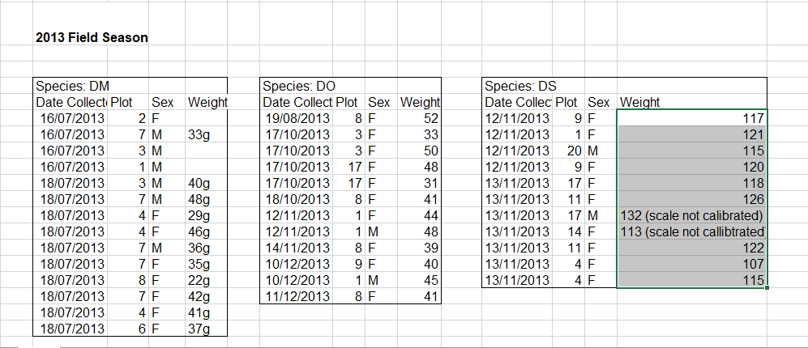
3. Formatting problems
Using multiple tables
A common strategy is creating multiple data tables within one spreadsheet…
This confuses the computer don’t do this!
When you create multiple tables within one spreadsheet, you’re forcing the computer to draw false associations between things: it sees each row as an observation.
You’re also potentially using the same field name in multiple places, which will make it harder to clean it
The example on the right depicts the problem:

Slide 25
3. Formatting problems
Using multiple tables
What about using workbook tabs??
This isn’t good practice for two reasons:
you are more likely to accidentally add inconsistencies to your data if each time you take a measurement, you start recording data in a new tab,
even if you manage to prevent all inconsistencies from creeping in, you will add an extra step for yourself before you analyse the data because you will have to combine these data into a single table.
You will have to explicitly tell the computer how to combine tabs

Slide 26
3. Formatting problems
Not filling in zeros
It might be that when you’re measuring something, it’s usually a zero, say the number of cows that an informant has, in a region where most farmers have goats and no cows. Why bother writing in the number zero in that column, when it’s mostly zeros?
there’s a difference between a zero and a blank cell in a spreadsheet!!!
A blank cell means that it wasn’t measured and the computer will interpret it as an unknown value

Slide 27

3. Formatting problems
Using problematic null values
Different software have different issues with way of representing a new value
Safe solution leave it blank
Example: using -999 or other numerical values (or zero) to represent missing data.
Solution: One common practice is to record unknown or missing data as -999, 999, or 0. Many statistical programs will not recognize that these are intended to represent missing (null) values. How these values are interpreted will depend on the software you use to analyse your data. It is essential to use a clearly defined and consistent null indicator.

Slide 28
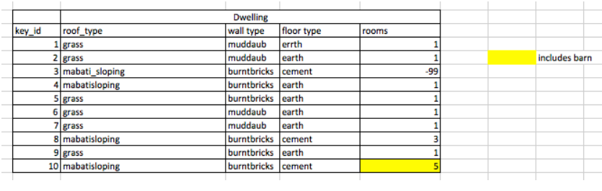
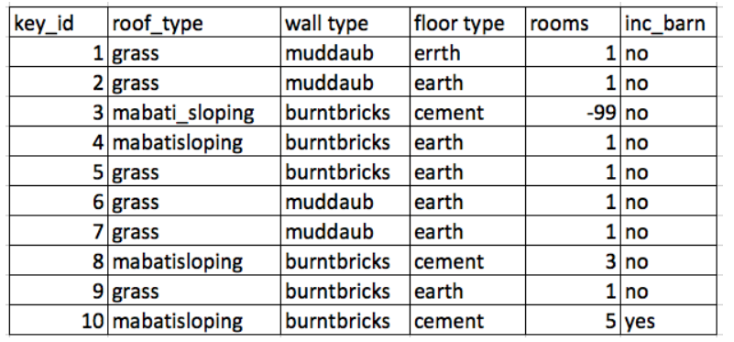
3. Formatting problems
Using formatting to convey information

Slide 29

3. Formatting problems
Using formatting to make the data sheet look pretty
Example: merging cells.
Solution: If you’re not careful, formatting a worksheet to be more aesthetically pleasing can compromise your computer’s ability to see associations in the data. Merged cells will make your data unreadable by statistics software. Consider restructuring your data in such a way that you will not need to merge cells to organize your data.

Slide 30
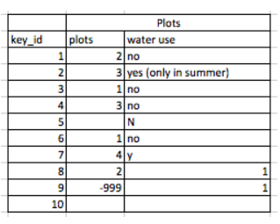
3. Formatting problems
Placing comments or units in cells
Example: Adding the unit of measurement in a numeric column.
Solution: Most analysis software can’t see Excel or LibreOffice comments, and would be confused by comments placed within your data cells. As described above for formatting, create another field if you need to add notes to cells. Similarly, don’t include units in cells: ideally, all the measurements you place in one column should be in the same unit, but if for some reason they aren’t, create another field and specify the units the cell is in.

Slide 31

3. Formatting problems
Entering more than one piece of information in a cell
Example: In the plot 4 of 2014 the species and sex of the observed animal are listed together
Solution: Don’t include more than one piece of information in a cell. This will limit the ways in which you can analyse your data. If you need both these types of information, design your data sheet to include this information. For example, include a separate column for species and sex.

Slide 32
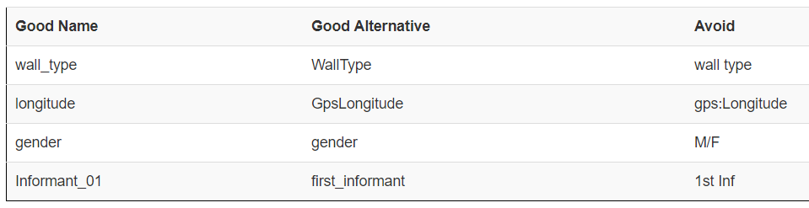
3. Formatting problems
Using problematic field names
Choose descriptive field names, but be careful not to include spaces, numbers, or special characters of any kind. Spaces can be misinterpreted by parsers that use whitespace as delimiters and some programs don’t like field names that are text strings that start with numbers.
Underscores (_) are a good alternative to spaces. Consider writing names in camel case (like this: ExampleFileName) to improve readability. Remember that abbreviations that make sense at the moment may not be so obvious in 6 months, but don’t overdo it with names that are excessively long. Including the units in the field names avoids confusion and enables others to readily interpret your variable names.

Slide 33

3. Formatting problems
Using special characters in data
Example: You treat your spreadsheet program as a word processor when writing notes, for example copying data directly from Word or other applications.
Solution: This is a common strategy. For example, when writing longer text in a cell, people often include line breaks, em-dashes, etc in their spreadsheet. Also, when copying data in from applications such as Word, formatting and fancy non-standard characters (such as left- and right-aligned quotation marks) are included. When exporting this data into a coding/statistical environment or into a relational database, dangerous things may occur, such as lines being cut in half and encoding errors being thrown.
General best practice is to avoid adding characters such as newlines, tabs, and vertical tabs. In other words, treat a text cell as if it were a simple web form that can only contain text and spaces.

Slide 34
3. Formatting problems
Key Points
Avoid using multiple tables within one spreadsheet.
Avoid spreading data across multiple tabs (but do use a new tab to record data cleaning or manipulations).
Record zeros as zeros.
Use an appropriate null value to record missing data.
Don’t use formatting to convey information or to make your spreadsheet look pretty.
Place comments in a separate column.
Record units in column headers.
Include only one piece of information in a cell.
Avoid spaces, numbers and special characters in column headers.
Avoid special characters in your data.

Slide 35

4. Dates as data
Questions
What are good approaches for handling dates in spreadsheets?
Objectives
Recognise regional, problematic or suspicious date formats (looking at you US date formats…).
Use formulas to separate dates into their component values (e.g. Month, Day, Year).

Slide 36
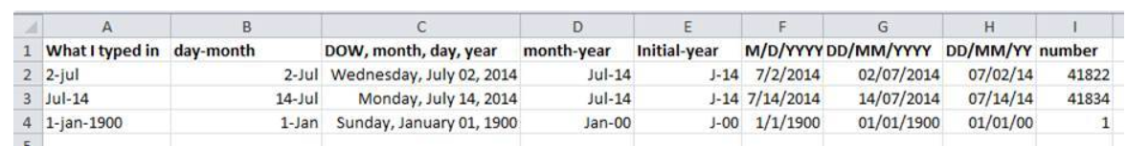
4. Dates as data
Date formats in spreadsheets
Dates in spreadsheets are often stored in a single column. While this seems the most natural way to record dates, it actually is not best practice.
A spreadsheet application will display the dates in a seemingly correct way (to a human observer) but how it actually handles and stores the dates may be problematic.
If you will later need to export the data you will have some problem
Spreadsheet programs have numerous “useful features” which allow them to handle dates in a variety of ways.

Slide 37
4. Dates as data
Dates stored as integers
The first thing you need to know is that Excel stores dates as numbers - see the last column in the above figure. Essentially, it counts the days from a default of December 31, 1899, and thus stores July 2, 2014 as the serial number 41822.
Excel also entertains a second date system, the 1904 date system, as the default in Excel for Macintosh. This system will assign a different serial number than the 1900 date system. Because of this, dates must be checked for accuracy when exporting data from Excel (look for dates that are ~4 years off).
It can actually be useful
By using it we can easily add days, months or years to a given date.
Say you had a research plan where you needed to conduct interviews with a set of informants every ninety days for a year.
In another cell, you could type:
=B2+90
And it would return
30-Sep
because it understands the date as a number 41822, and 41822 + 90 = 41912 which Excel interprets as the 30th day of September, 2014. It retains the format (for the most part) of the cell that is being operated upon, (unless you did some sort of formatting to the cell before, and then all bets are off). Month and year rollovers are internally tracked and applied.

Slide 38

4. Dates as data
Regional date formatting
When you enter a date into a spreadsheet it looks like a date although the spreadsheet may display different. If you enter ‘7/12/88’ into your Excel spreadsheet it may display as ‘07/12/1988’
These are different ways of formatting the same date.
Different countries write dates differently.
If you are in the UK, for example, you will interpret the date above as the 7th day of December, however a research from the US will interpret the same entry as the 12th day of July.
This regional variation is handled automatically by your spreadsheet program so that when you are typing in dates they appear as you would expect.
If you try to type in a US format date into a UK version of Excel, it may or may not be treated as a date.

Slide 39
4. Dates as data
Challenge 1
Download the SAFI_dates.xlsx file.
Open the file.
Choose the tab of the spreadsheet that corresponds to the way you format dates in your location (either the “correct” way, or the “incorrect” way.
Extract the components of the date to new columns. For this we can use the built in Excel functions:
=MONTH()
=DAY()
=YEAR()
Apply each of these formulas to its entire column. Make sure the new column is formatted as a number and not as a date.
We now have each component of our date isolated in its own column. This will allow us to group our data with respect to month, year, or day of month for our analyses and will also prevent problems when passing data between different versions of spreadsheet software (as for example when sharing data with collaborators in different countries).

Slide 40

4. Dates as data
Challenge 2
Using the same spreadsheet you used for the previous exercise, add another data point in the date Collection by typing either 11/17 (if your location uses MM/DD formatting) or 17/11 (if your location uses DD/MM formatting)
What year is shown in the Year column?
Excel is unable to parse dates from before 1899-12-31, and will thus leave these untouched. If you’re mixing historic data from before and after this date, Excel will translate only the post-1900 dates into its internal format, thus resulting in mixed data.
If you’re working with historic data, be extremely careful with your dates!

Slide 41

4. Dates as data
Key Points
Use extreme caution when working with date data.
Splitting dates into their component values can make them easier to handle.
Notes:
Many programming softwares have packages built specifically for date as data! That’s how tricky it can be – people went out of their way to develop and design tools to deal with date data.

Slide 42

5. Quality assurance
Questions
How can we carry out basic quality assurance in spreadsheets?
Objectives
Apply quality assurance techniques to limit incorrect data entry.
Notes:
When you have a well-structured data table, you can use several simple techniques within your spreadsheet to ensure the data you enter is free of errors.

Slide 43
5. Quality assurance
Validating data on input
It is possible that the nature of the data contained in the table allows us place additional restrictions on the acceptable values for cells in a column.
For example; a column recording age should be numeric, greater than 0 and is unlikely to be greater than 120.
Excel allows us to specify a variety of data validations to be applied to cell contents.
If the validation fails an error is raised, and the data we entered does not go into the cell.
For an overview of data validation rules available in Excel, check out the Excel support page on data validation.
Notes:
When we input data into a cell of a spreadsheet we are typically not constrained in the type of data we enter. In any one column, the spreadsheets software will not warn us if we start to enter a mix of text, numbers or dates in different rows. Even if we are not facing constraints from the software, as a researcher we often anticipate that all data in one column will be of a certain type. It is also possible that the nature of the data contained in the table allows us to place additional restrictions on the acceptable values for cells in a column. For example a column recording age in years should be numeric, greater than 0 and is unlikely to be greater than 120.
Excel allows us to specify a variety of data validations to be applied to cell contents. If the validation fails, an error is raised and the data we entered does not go into the particular cell. In addition to providing validation when we enter data, Excel allows us to add validations to data that has already been entered. The validation is not applied retrospectively, so that data are removed. Instead, if a particular cell would fail the validation check a triangle is placed in the top left corner of the cell as a warning.

Slide 44

5. Quality assurance
Validating data on input
In addition to providing validation when we enter data, Excel allows us to add validations to data that has already been entered.
The validation is not applied retrospectively, so that data are removed.
Instead, if a particular cell would fail the validation check a triangle is placed in the top left corner of the cell as a warning.
We will look at two examples:
Restricting data to a numeric range
Restricting data to entries from a list
Notes:
Excel allows us to specify a variety of data validations to be applied to cell contents. If the validation fails, an error is raised and the data we entered does not go into the particular cell. In addition to providing validation when we enter data, Excel allows us to add validations to data that has already been entered. The validation is not applied retrospectively, so that data are removed. Instead, if a particular cell would fail the validation check a triangle is placed in the top left corner of the cell as a warning.

Slide 45
5. Quality assurance
Restricting data to a numeric range
Looking again at the clean version of the dataset, we see that the weight column is numeric.
We would expect this always to be a positive integer, and so we should reject values like 1.5 and -8 as entry errors.
We would also reject values over a certain maximum - for example an entry like 90 is probably the result of the researcher inputting 9 and their finger slipping and also hitting the 0 key.
It is up to you as the researcher to decide what a reasonable maximum value would be for your data (best done with references to scare away potential #reviewer_2 suggestions).
Here we will assume that there are no families with greater than 30 members.

Slide 46
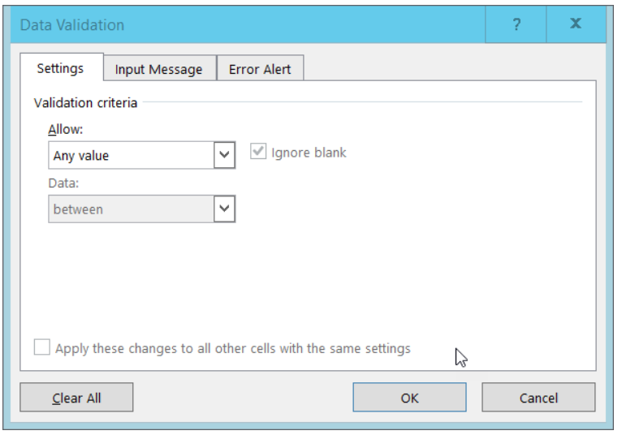
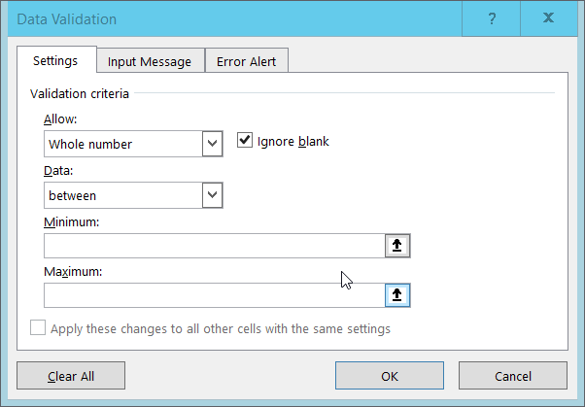
5. Quality assurance
Restricting data to a numeric range
Select the no_membrs column.
2. On the Data tab select Data Tools and then Data Validation or Validation Tools (depending on your version of Excel). The following tab will appear:
3. Select ‘Whole number’ from the Allow drop down options. (In Libre Office choose Allow: Whole Numbers and then Data: valid range).
4. The window content will change. The value in the data box will say ‘between’ and Minimum and Maximum boxes will be provided for you to specify an allowed range.
5. Fill in the minimum and maximum values that make sense for your data and click Ok. Here we will choose a minimum of 1 and a maximum of 30.

Slide 47
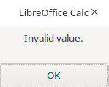
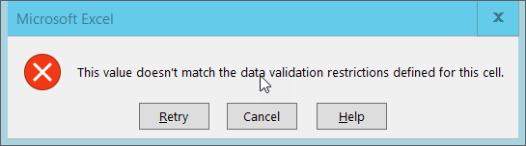
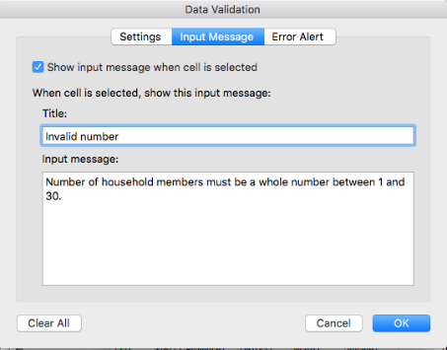
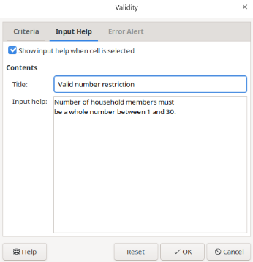
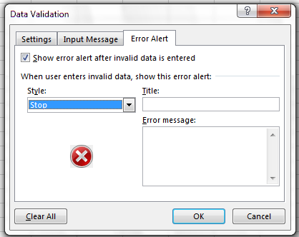
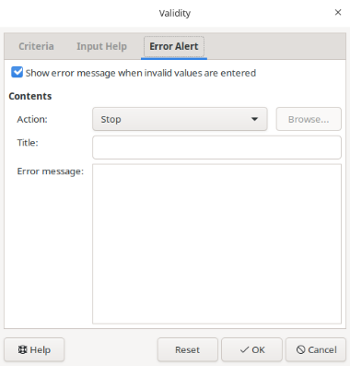
5. Quality assurance
Restricting data to a numeric range
Your data table will now not allow you to enter a value that violates the data validation rule you have created. To test this out, try to enter a new value into the no_membrs column that is not valid. The following error box will appear in Excel:
You can also customize the resulting message to be more informative by entering your own message in the Input Message tab when creating a data validation rule.
You can also allow invalid data to result in a warning rather than an error by modifying the Style option on the Error Alert tab. For Excel you will see:

Slide 48
5. Quality assurance
Challenge 1
Apply a new data validation rule to one of the other numeric columns in this data table.
Discuss what a reasonable rule would be for the column you’ve selected.
Be sure to create an informative input message.

Slide 49

5. Quality assurance
Restricting data to entries from a list
Quality assurance can make data entry easier as well as more robust. For example, if you use a list of options to restrict data entry, the spreadsheet will provide you with a drop-down list of the available items. So, instead of trying to remember if you spell F and M in the sex capital or not you can set a drop down list.
1. Select the Sex column.
2. On the Data tab select Data Tools and then Data Validation or Validation Tools (depending on your version of Excel). The following tab will appear:
3. Select List from the Allow drop-down menu.
4. The window will change to include a Source box.
5. Type a list of all the values that you want to be accepted in this column, separated by commas. For us this will be F;M. NB old version of excel “F,M”
6. Create a meaningful input message, then click OK.

Slide 50
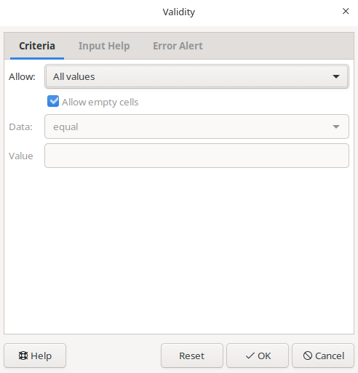
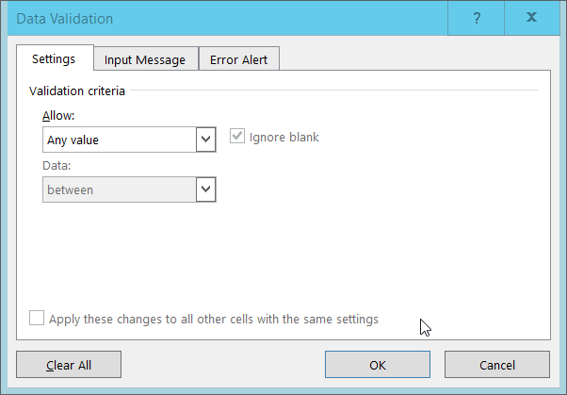
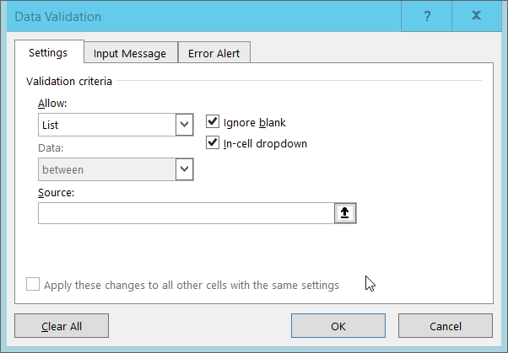
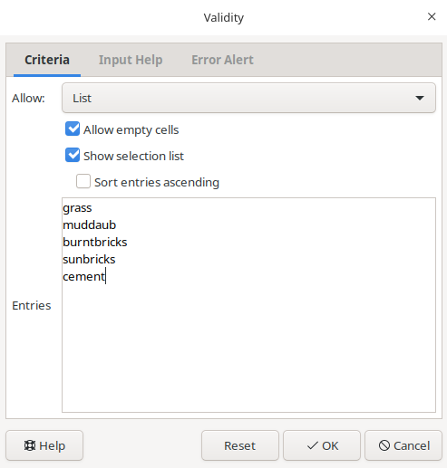
5. Quality assurance
Restricting data to entries from a list
Select the respondent_wall_type column.
2. In Excel, nn the Data tab select Data Tools and then Data Validation or Validation Tools (depending on your version of Excel). The following tab will appear:
3. Select List from the Allow drop-down menu.
4. The window will change to include a Source box.
5. Type a list of all the values that you want to be accepted in this column, separated by commas. For us this will be “grass, muddaub, burntbricks, sunbricks, cement”. In LibreOffice, your entries of grass, muddaub, burntbricks, sunbricks and cement should be on new lines as shown below
6. Create a meaningful input message, then click OK.

Slide 51
5. Quality assurance
Challenge 2
Apply a new data validation rule to one of the other categorical columns in this data table. Discuss with the person sitting next to you what a reasonable rule would be for the column you’ve selected. Be sure to create an informative input message.
Tip 2
You may have noticed that data validation rules are not applied retroactively to data that is already present in the cell.
This means, for example, that if we had already entered 2300 in the weight column before applying our data validation rule, that cell would not be flagged with a warning.
When using spreadsheets for data entry, it is a good idea to set up data validation rules for each column when you set up your spreadsheet (i.e. before you enter any data).

Slide 52
6. Exporting data
Questions
How can we export data from spreadsheets in a way that is useful for downstream applications?
Objectives
Store spreadsheet data in universal file formats.
Export data from a spreadsheet to a CSV file.

Slide 53
6. Exporting data
Why not store in .xls or .xlsx?
Because it is a proprietary format, and it is possible that in the future, technology won’t exist
Other spreadsheet software may not be able to open files
Different versions of Excel may handle data differently, leading to inconsistencies.
Finally, more journals are requiring you to deposit your data in a data repository and they could not be in .xls
The above points also apply to other formats such as open data formats used by LibreOffice.
Notes:
As an example of inconsistencies in data storage, do you remember how we talked about how Excel stores dates earlier? It turns out that there are multiple defaults for different versions of the software, and you can switch between them all. So, say you’re compiling Excel-stored data from multiple sources. There’s dates in each file- Excel interprets them as their own internally consistent serial numbers. When you combine the data, Excel will take the serial number from the place you’re importing it from, and interpret it using the rule set for the version of Excel you’re using. Essentially, you could be adding errors to your data, and it wouldn’t necessarily be flagged by any data cleaning methods if your ranges overlap.

Slide 54
6. Exporting data
What can we do instead?
Try tab-delimited (tab separated values or TSV) or comma-delimited (comma separated values or CSV).
CSV files are plain text files where the columns are separated by commas, hence ‘comma separated values’ or CSV.
Data in a CSV file can also be easily imported into other formats and environments.
We’re not tied to a certain version. Most spreadsheet programs can save to delimited text formats like CSV easily, although they may give you a warning during the file export.
Notes:
Storing data in a universal, open, and static format will help deal with this problem. Try tab-delimited (tab separated values or TSV) or comma-delimited (comma separated values or CSV). CSV files are plain text files where the columns are separated by commas, hence ‘comma separated values’ or CSV. The advantage of a CSV file over an Excel/SPSS/etc. file is that we can open and read a CSV file using just about any software, including plain text editors like TextEdit or NotePad. Data in a CSV file can also be easily imported into other formats and environments, such as SQLite and R. We’re not tied to a certain version of a certain expensive program when we work with CSV files, so it’s a good format to work with for maximum portability and endurance. Most spreadsheet programs can save to delimited text formats like CSV easily, although they may give you a warning during the file export.

Slide 55
6. Exporting data
How to save a file opened in Excel in CSV:
From the top menu select File and Save as.
In the Format field, from the list, select Comma Separated Values (*.csv).
Double check the file name and the location where you want to save it and hit Save.
An important note for backwards compatibility: you can open CSV files in Excel!
Notes:
Storing data in a universal, open, and static format will help deal with this problem. Try tab-delimited (tab separated values or TSV) or comma-delimited (comma separated values or CSV). CSV files are plain text files where the columns are separated by commas, hence ‘comma separated values’ or CSV. The advantage of a CSV file over an Excel/SPSS/etc. file is that we can open and read a CSV file using just about any software, including plain text editors like TextEdit or NotePad. Data in a CSV file can also be easily imported into other formats and environments, such as SQLite and R. We’re not tied to a certain version of a certain expensive program when we work with CSV files, so it’s a good format to work with for maximum portability and endurance. Most spreadsheet programs can save to delimited text formats like CSV easily, although they may give you a warning during the file export.

Slide 56
6. Exporting data
What to do when your data contain commas?
In some datasets, the data values themselves may include commas (,). In that case, you need to make sure that the commas are properly escaped when saving the file.
Otherwise, the software which you use (including Excel) will most likely incorrectly display the data in columns. This is because the commas which are a part of the data values will be interpreted as delimiters.
If you are working with data that contains commas, the fields should be enclosed with double quotes.
The spreadsheet software should do the right thing (LibreOffice provides comprehensive options to import and export CSV files).
However, it is always a good idea to double check that the file you are exporting can be read in correctly.
For more of a discussion on data formats and potential issues with commas within datasets see the Ecology Spreadsheets lesson discussion page.

Slide 57

6. Exporting data
A note on R and xls
There are R packages that can read xls files (as well as Google spreadsheets).
It is even possible to access different worksheets in the xls documents.
However, because these packages parse data tables from proprietary and non-static software, there is no guarantee that they will continue to work on new versions of Excel.
Exporting your data to CSV or TSV format is much safer and more reproducible!!!

Slide 58

6. Exporting data
Key Points
Data stored in common spreadsheet formats will often not be read correctly into data analysis software, introducing errors into your data.
Exporting data from spreadsheets to formats like CSV or TSV puts it in a format that can be used consistently by most programs.

